Slide 1
Testing methods
Black box vs. White box testing
Performance testing
System Testing
Jimmy Stauder

Slide 2
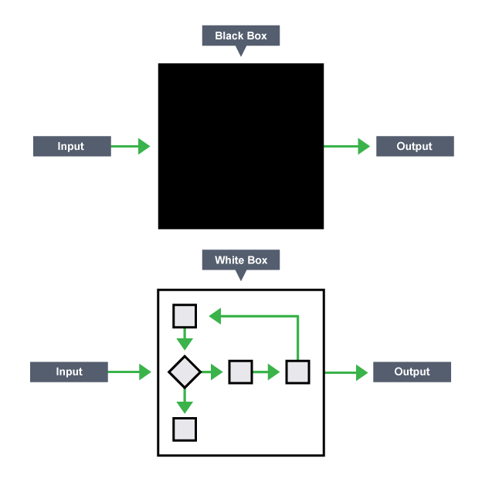
Black Box vs. White box

Slide 3

Black Box
Black box testing is done with ignorance of inside workings of the software.
Black box development should be done throughout development on various “black boxes” of the software(e.g., functions).
Black box testing is strictly focused on input and output and not on the program’s control structure. (Barker, n.d.).
Pros | Cons
No need for knowledge of programming(HINT: AUTOMATION) | Testing every possible input can be impossible for some situations
Can reveal problems developer did not anticipate | Can be redundant if run by developer
Can be done on individual units of software | Requires to clear and concise specifications. How’s that SRS looking?

Slide 4
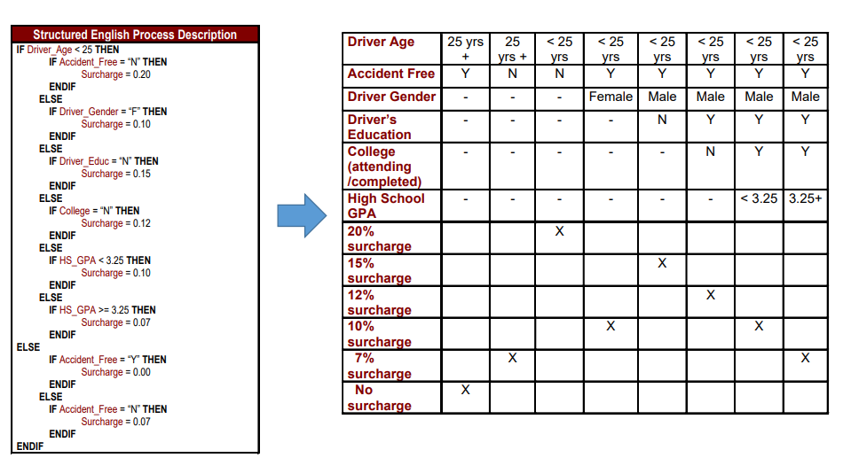
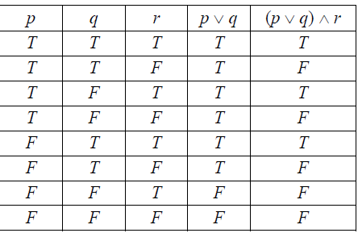
Black box testing techniques
All-Pairs testing
Decision table testing

Slide 5

White Box Testing
White box testing is done with knowledge of the internal workings and structure of a piece of software.
Can be extremely important to make code more efficient as hidden bottlenecks get revealed.
Like Black box testing, White box testing should be done throughout development on various different units.
(Khan, 2011).
Pros | Cons
Can lead to optimization opportunities | Cost(time)
Faster than Black Box testing | Can miss cases
Can lead to design flaws | Can be wasted if code base changes. This could be caused by an incomplete or poorly designed SRS.

Slide 6
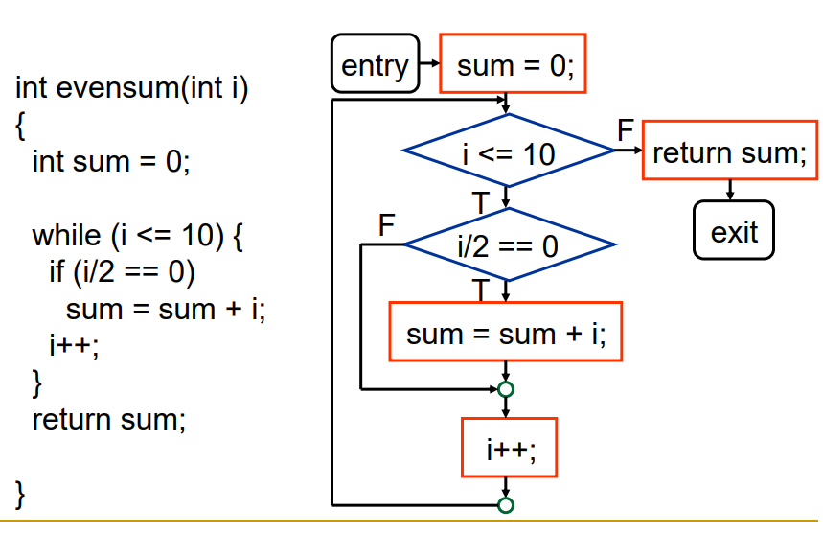
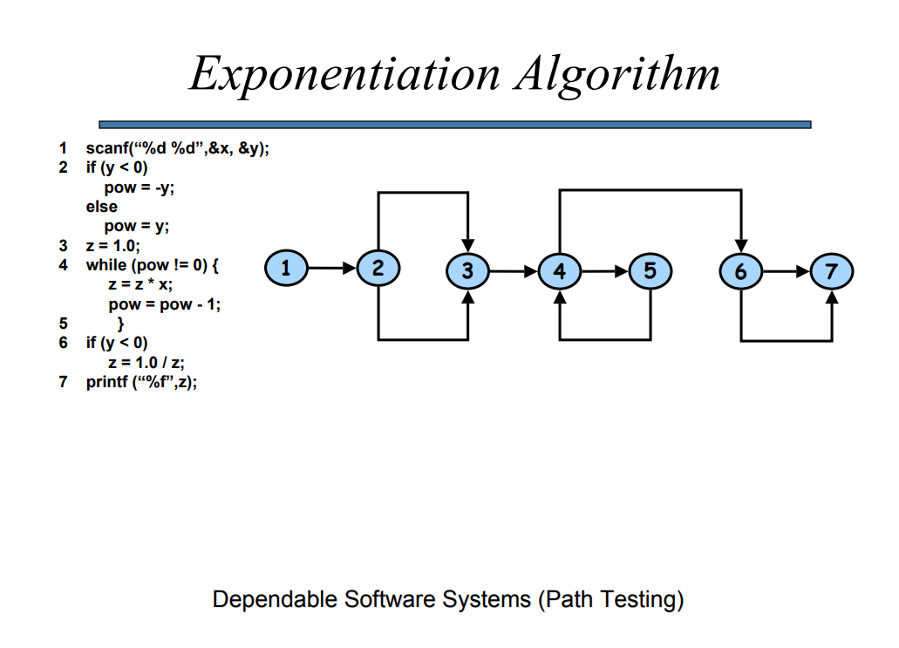
White box design techniques
Control Flow Graph
Path Testing

Slide 7
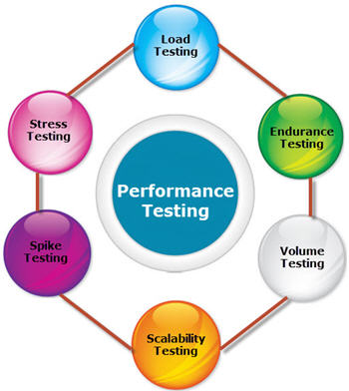
Performance Testing
Performance testing is performed to see if software performs under a particular workload.
Different types of performance testing should be done throughout all stages of the development.
The requirements of the performance testing should be clear before development. Have I asked you how your SRS looks?
Every piece of software should undergo some version of performance testing

Slide 8

Load Testing
Load testing puts the system under a demand and measures its response. Load testing is usually done to determine how capable a system is in normal and even high stress conditions.
Load testing is specifically done to measure the expected usage of a system across various users simultaneously.
Load testing ideally is done as close to production as possible. It is likely unrealistic to load test during the initial stages of production.
Load testing often results in some sort of reproduction of a system.

Slide 9
Steps to doing a load test
Keep the user in mind
Identify the goal of the software
Identify particular measures of performance
Choose a tool right for your project
Create test cases
Run your tests

Slide 10

Examples of load testing questions
Can the server run multiple applications
Can the database handle multiple queries
Can the server download uploaded documents from a user while maintaining other functionality
Can the server read data from hard disk at a steady pace

Slide 11
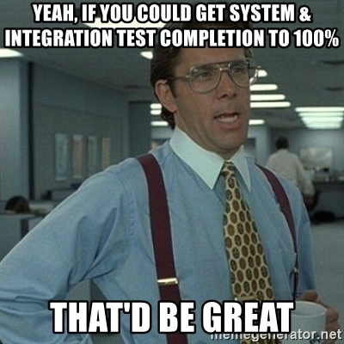
System Testing
System testing of a software is the process of testing the complete version of that software.
System testing is incorrect if any portion of the testing occurs prior to the completion of the software.
System testing is a form of black box testing.
System testing is mainly used to find incompatibilities with different modules within the system. (Remember this should take place after each module has been tested in isolation).
Often times the longest , most rigorous, and redundant testing method.
(Bruegge and Dutoit, n.d.)

Slide 12
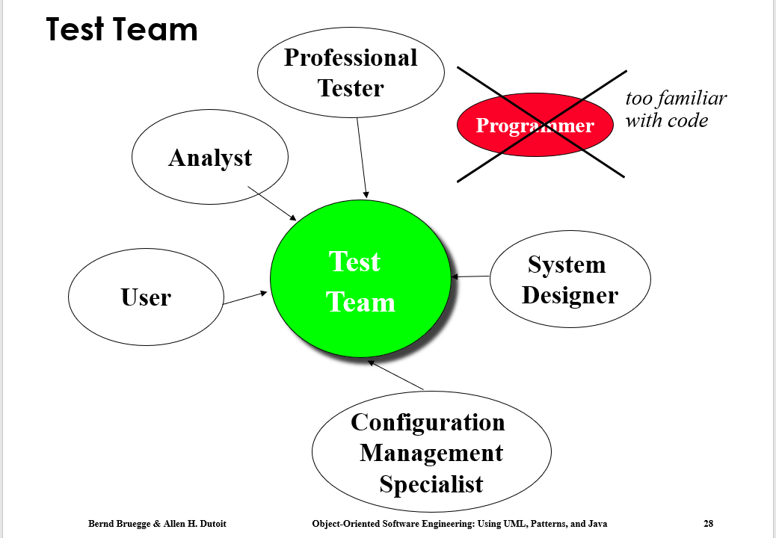
Criteria in order to system test
Complete software product
Unit testing completed
Integration testing completed
Specifications completed
Might be unrealistic for our class but a testing team that does NOT include the programmer

Slide 13
Different types of System Testing
Functional Testing – validates functional requirements
Performance Testing – validates non-functional requirements
Acceptance Testing – validates clients expectations

Slide 14

Questions?

Slide 15
Various links
More complete path testing strategies
Guide to good performance testing for Web applications
Performance testing documentation template
List of performance testing software
System testing plan template

Slide 16
References
Barker, Cory. (n.d.). Black Box Testing.
Retrieved from
faculty.cs.byu.edu/~barker/cs240/notes/26-bbox-test/BlackBoxTesting.pdf
Khan, Ehmer. (July 2011). “Different Approaches to White Box Testing Techniques for Finding Errors.” International Journal of Software Engineering and Its Applications. Retrieved 10 February 2018.
Bruegge, Bernd and Dutoit, Allen. (n.d.). PowerPoint presentation. Chapter 11, Testing, Part 2: Integration and System testing.
Retrieved from www.cs.bilkent.edu.tr/~hozgur/teaching/cs319/resources/slides/ch11lect2_UD.ppt

